Slide 1
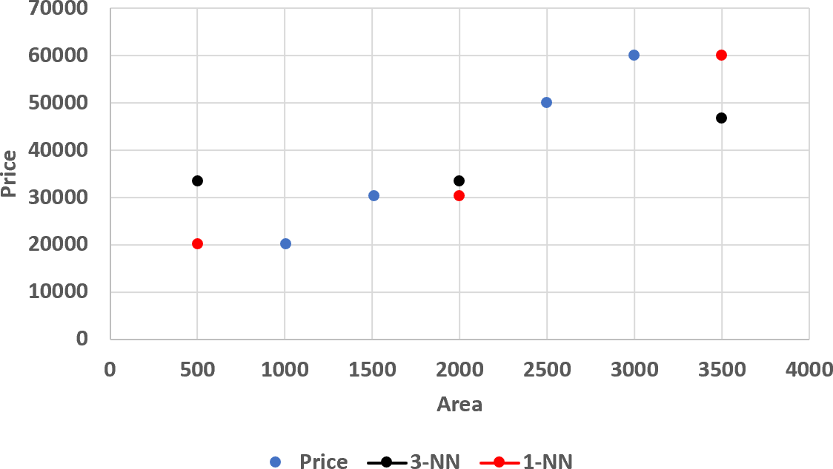
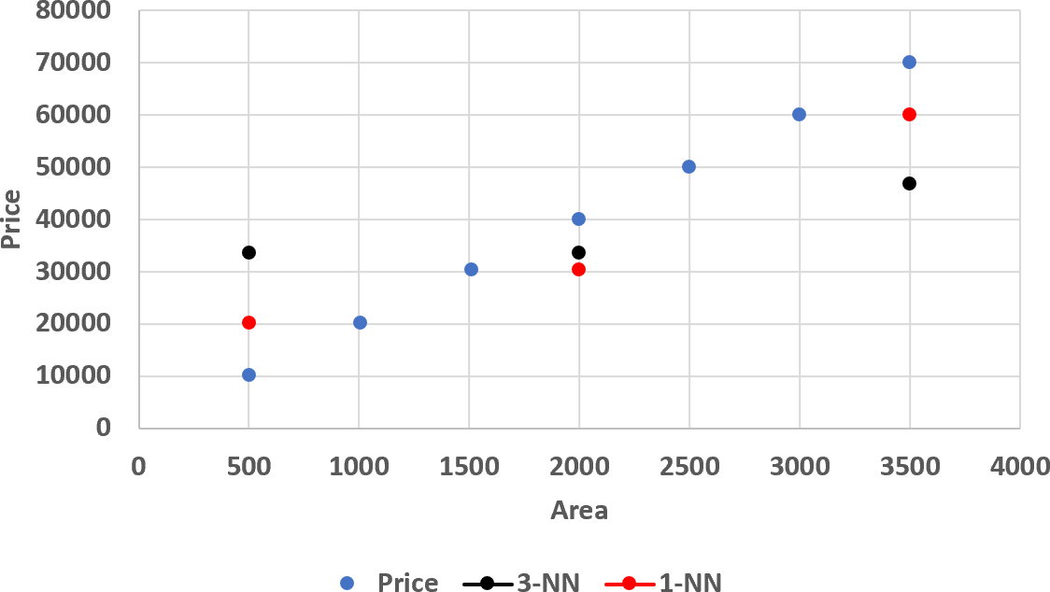


Find the price of house!
Area | Price
1,510 | 30,250
1,005 | 20,150
2,500 | 50,050
3,000 | 60,050
𝒚 = 𝒎𝒙 + 𝒃
Price for Area: 500? 2000?, 3500?
Area | 1-NN | 3-NN
500 | 20,150 | 30,150
2,000 | 30,250 | 33,483.33
3,500 | 60,050 | 50,050
3

Slide 2
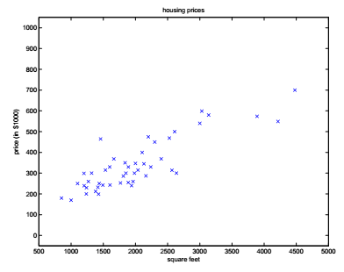
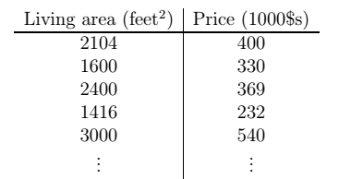
Linear Regression with ONE variable
Suppose we have a dataset with living area and prices of houses in US

Slide 3
Linear Regression with ONE variable
Supervised/unsupervised?
Classification/regression/clustering?
Notations:
m = number of training examples
x’s = input variable/feature
y’s = output/target variable
(x,y)=one training example
(x^{(i),}y^{(i)})= i^{th} training example
{(x^{(i),}y^{(i)});i=1,…….,m} = training set

Slide 4
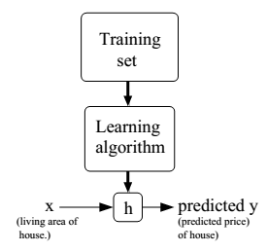
Supervised Learning Formal Definition
Learning algorithm outputs a function h, also called as hypothesis.
h takes as input (x), the size
of the house and outputs
the estimated value of y
h maps input x to output y
How to represent h?

Slide 5


Linear Regression with one variable
Size (𝒇𝒆𝒆𝒕^{𝟐}) | Price $(×1000)
1500 | 190
2250 | 285
2740 | 420
2318 | 300
2500 | 350
1250 | 180
… | …
500
400
Price ³⁰⁰
(in 1000s of ₂₀₀
dollars)
100
0
0
500
1000 1500 2000 2500 3000
Size (feet²)
Notation:
𝒎
𝒏
𝒙_{𝒋}
𝒚
= Number of training samples
= Number of features
= 𝑗th feature
= Label
(𝒙^{𝒊}, 𝒚^{𝒊}): the 𝑖𝑡ℎ sample in the dataset
5

Slide 6

Linear Regression with one variable
𝒉_{𝜽} 𝒙 = 𝜽_{𝟎} + 𝜽_{𝟏}𝒙
6
y
4
Linear regression with one variable, univariate linear regression, simple linear regression
Parameters
𝜃₀, 𝜃₁
Cost function
2
0
1 2
x
3 4
Choose 𝜽_{𝟎}, 𝜽_{𝟏} such that 𝒉_{𝜽}(𝒙) ≈ 𝒚
for our training examples (𝒙, 𝒚).
Goal:
𝑀𝑖𝑛𝑖𝑚𝑖𝑧𝑒_{𝜃0,𝜃1} 𝐽(𝜃₀, 𝜃₁)
6

Slide 7
Linear Regression with one variable
𝒉_{𝜽} 𝒙 = 𝜽_{𝟎} + 𝜽_{𝟏}𝒙
6
Linear regression with one variable, univariate linear regression, simple linear regression
Parameters
𝜃₀, 𝜃₁
Cost function
y
4
2
0
1 2
x
3 4
Choose 𝜽_{𝟎}, 𝜽_{𝟏} such that 𝒉_{𝜽}(𝒙) ≈ 𝒚
for our training examples (𝒙, 𝒚).
Goal:
𝑀𝑖𝑛𝑖𝑚𝑖𝑧𝑒_{𝜃0,𝜃1} 𝐽(𝜃₀, 𝜃₁)

Slide 8
A simplified case
Assume 𝜽_{𝟎} = 𝟎
Hypothesis
ℎ_{𝜃}
Parameters
Hypothesis
𝑥 = 𝜃₀ + 𝜃₁𝑥
ℎ_{𝜃} 𝑥
= 𝜃₁𝑥
Parameters
𝜃₀, 𝜃₁
𝜃₁
Cost function
Cost function
Goal:
Goal:
𝑀𝑖𝑛𝑖𝑚𝑖𝑧𝑒_{𝜃0,𝜃1} 𝐽(𝜃₀, 𝜃₁)
𝑀𝑖𝑛𝑖𝑚𝑖𝑧𝑒_{𝜃1} 𝐽(𝜃₁)

Slide 9












𝒉_{𝜽} 𝒙 = 𝜽_{𝟏}𝒙
𝑱 𝜽_{𝟏}
(function of the parameter 𝜃₁)
(for a fixed 𝜃₁, this is a function of 𝑥)
3
𝟏
𝑱 𝟏 =
𝟐(𝟑)
𝟏 − 𝟏 ^{𝟐} + 𝟐 − 𝟐 ^{𝟐} + 𝟑 − 𝟑 ^{𝟐} = 𝟎
θ₁ =1
θ₁ =0.5
𝟏
𝑱 𝟎. 𝟓 =
2
𝟔
𝟎. 𝟓 − 𝟏 ^{𝟐} + 𝟏 − 𝟐 ^{𝟐} + 𝟏. 𝟓 − 𝟑 ^{𝟐} = 𝟎. 𝟓𝟖
y
𝟏
𝑱 𝟎 =
_{𝟑} 𝟐
𝟔
𝟏 ^{𝟐} + 𝟐 ^{𝟐} + = 𝟐. 𝟑
1
3
θ₁ =0
Minimizes 𝑱(𝜽_{𝟏})
0
2
1 2 3
0
x
1
𝑚
0
1
-0.5
0 0.5 1 1.5 2 2.5
𝐽 𝜃
෍(𝜃 𝑥 ^{𝑖}
_{− 𝑦}(𝑖)₎2
1
2𝑚
1
𝑖=1

Slide 10
Using both of the “knobs”
Hypothesis
ℎ_{𝜃} 𝑥 = 𝜃₀ + 𝜃₁𝑥
Parameters
𝜃₀, 𝜃₁
Cost function
Goal:
𝑀𝑖𝑛𝑖𝑚𝑖𝑧𝑒_{𝜃0,𝜃1} 𝐽(𝜃₀, 𝜃₁)

Slide 11
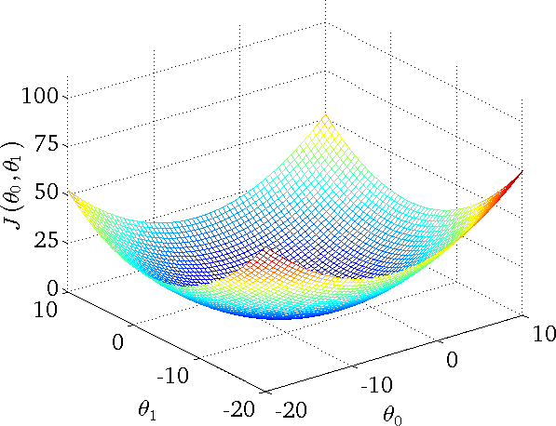

𝒉_{𝜽} 𝒙 = 𝜽_{𝟎} + 𝜽_{𝟏}𝒙
(for fixed 𝜃₀, 𝜃₁, this is a function of 𝑥)
𝑱 𝜽_{𝟎}, 𝜽_{𝟏}
(function of the parameters 𝜃₀, 𝜃₁)
500
Price ($) in 1000’s (y)
400
300
200
100
0
0
1000
2000
Size in feet² (x)
3000

Slide 12
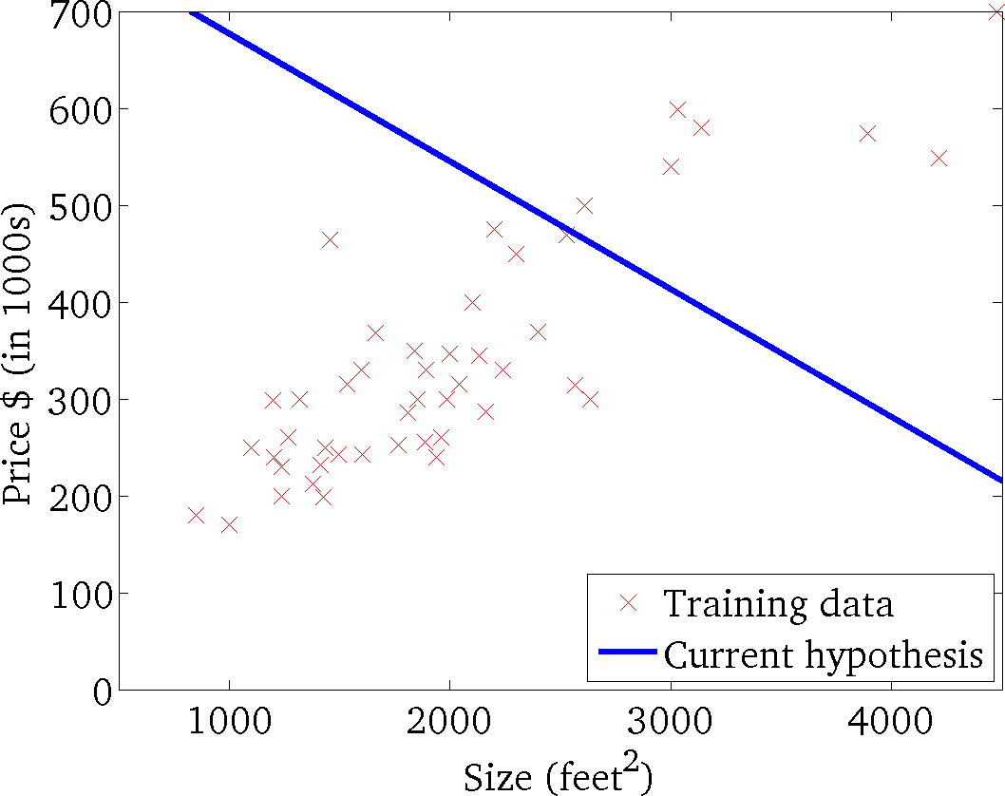
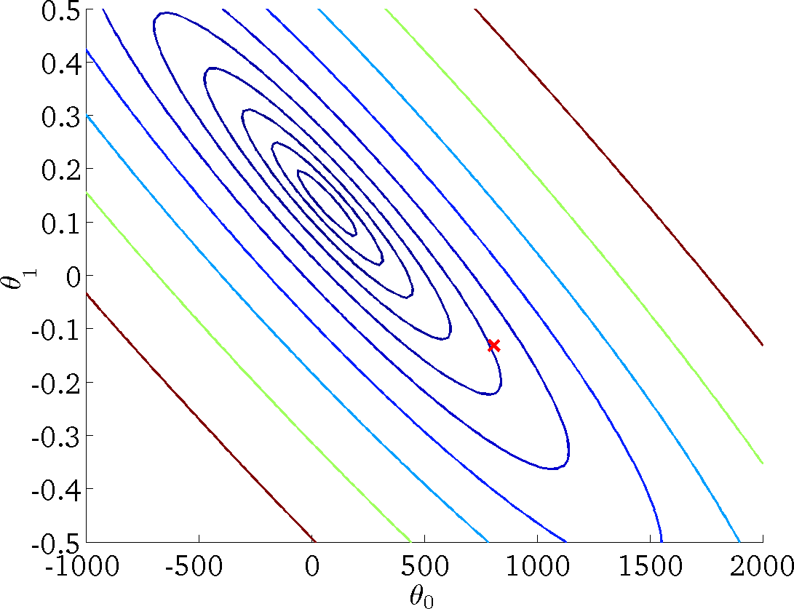
𝒉_{𝜽} 𝒙 = 𝜽_{𝟎} + 𝜽_{𝟏}𝒙
(for fixed 𝜃₀, 𝜃₁, this is a function of 𝑥)
𝑱 𝜽_{𝟎}, 𝜽_{𝟏}
(function of the parameters 𝜃₀, 𝜃₁)
Andrew Ng

Slide 13
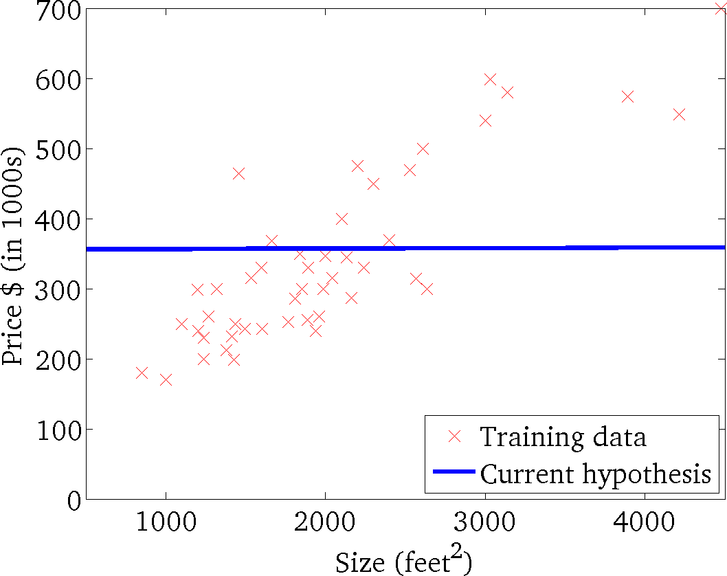
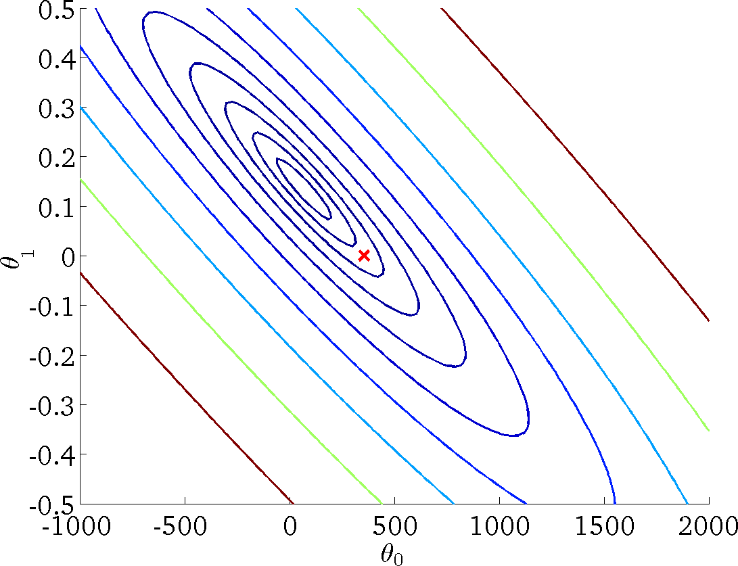
𝒉_{𝜽} 𝒙 = 𝜽_{𝟎} + 𝜽_{𝟏}𝒙
(for fixed 𝜃₀, 𝜃₁, this is a function of 𝑥)
𝑱 𝜽_{𝟎}, 𝜽_{𝟏}
(function of the parameters 𝜃₀, 𝜃₁)
Andrew Ng

Slide 14
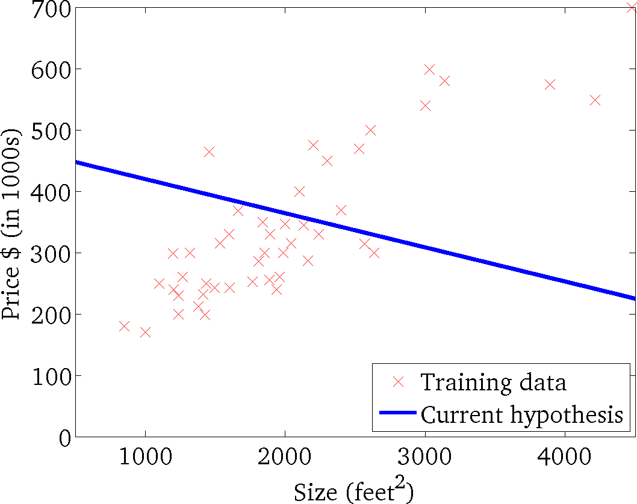

𝒉_{𝜽} 𝒙 = 𝜽_{𝟎} + 𝜽_{𝟏}𝒙
(for fixed 𝜃₀, 𝜃₁, this is a function of 𝑥)
𝑱 𝜽_{𝟎}, 𝜽_{𝟏}
(function of the parameters 𝜃₀, 𝜃₁)
Andrew Ng

Slide 15

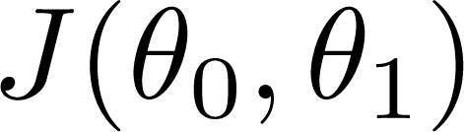


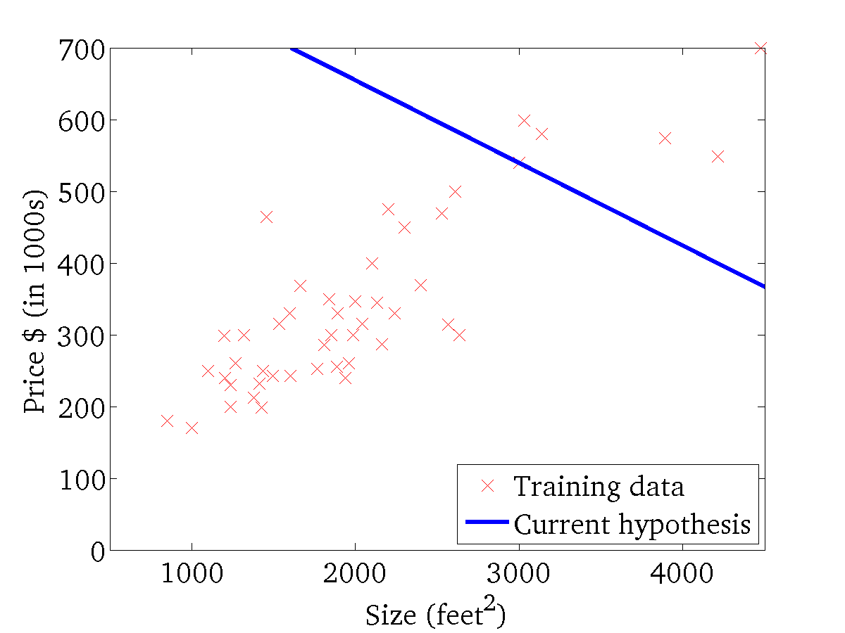
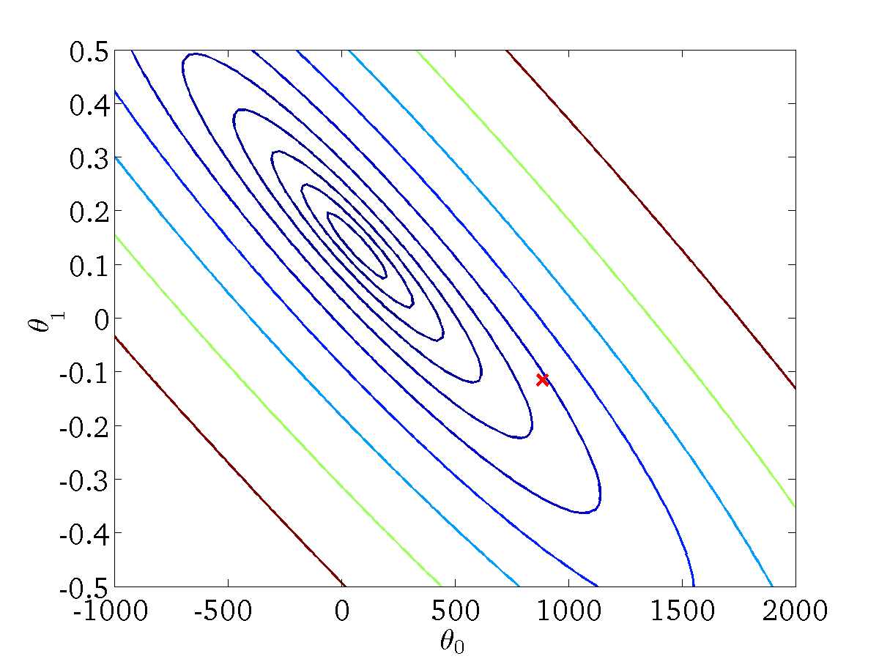
(for fixed , this is a function of x)
(function of the parameters )

Slide 16
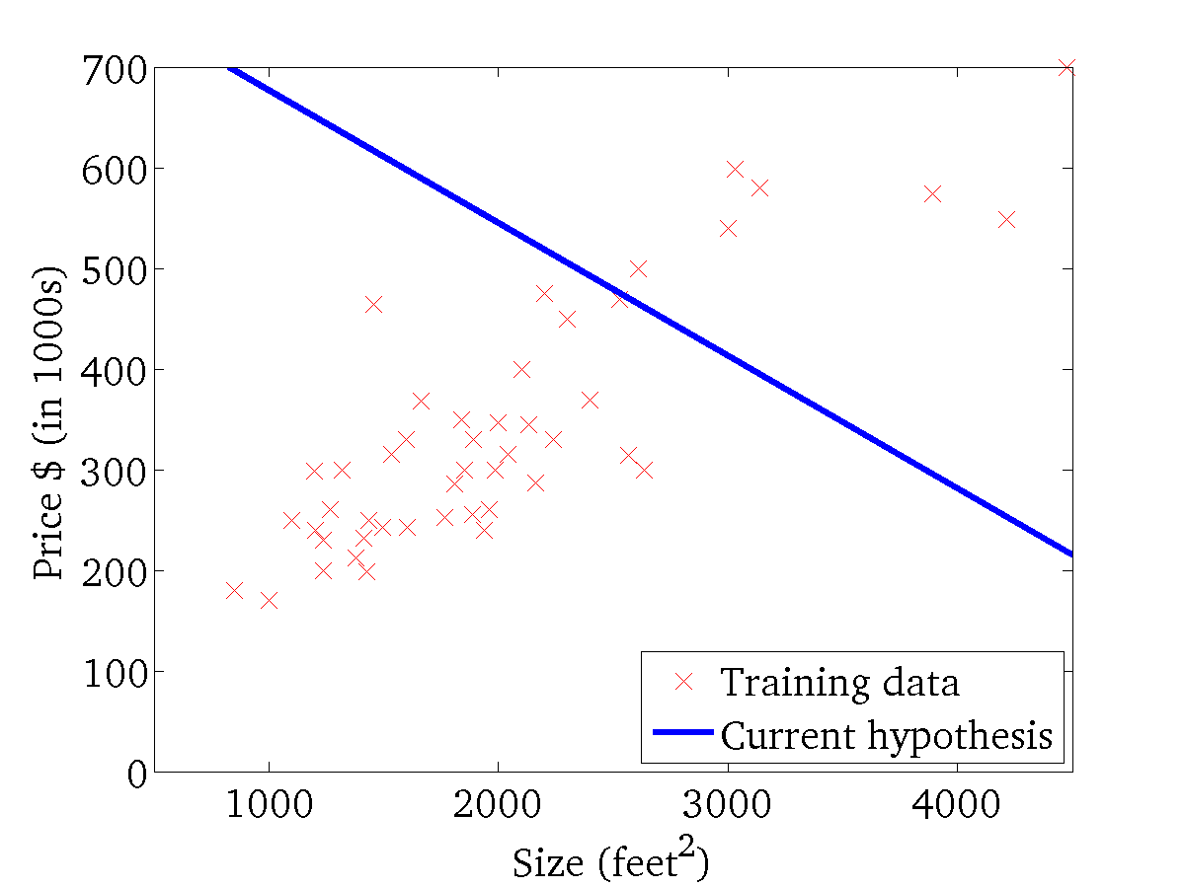

(for fixed , this is a function of x)
(function of the parameters )

Slide 17
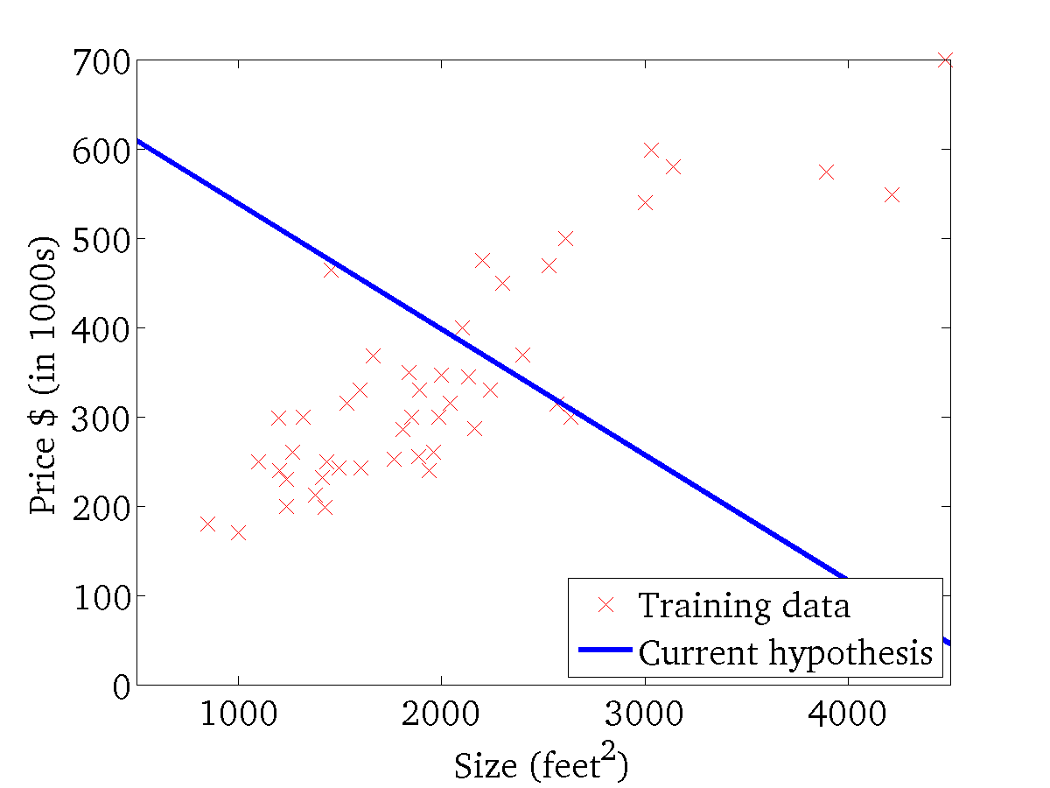
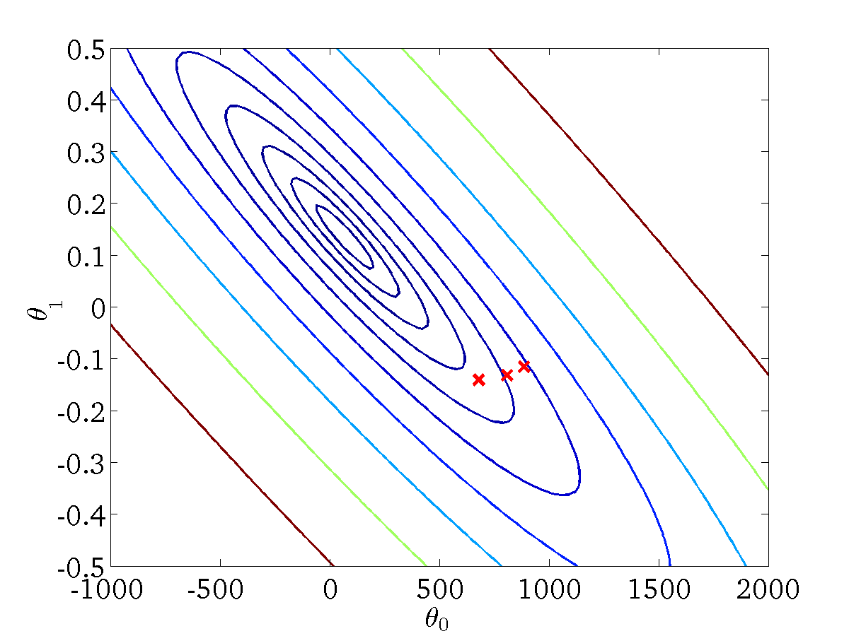
(for fixed , this is a function of x)
(function of the parameters )

Slide 18
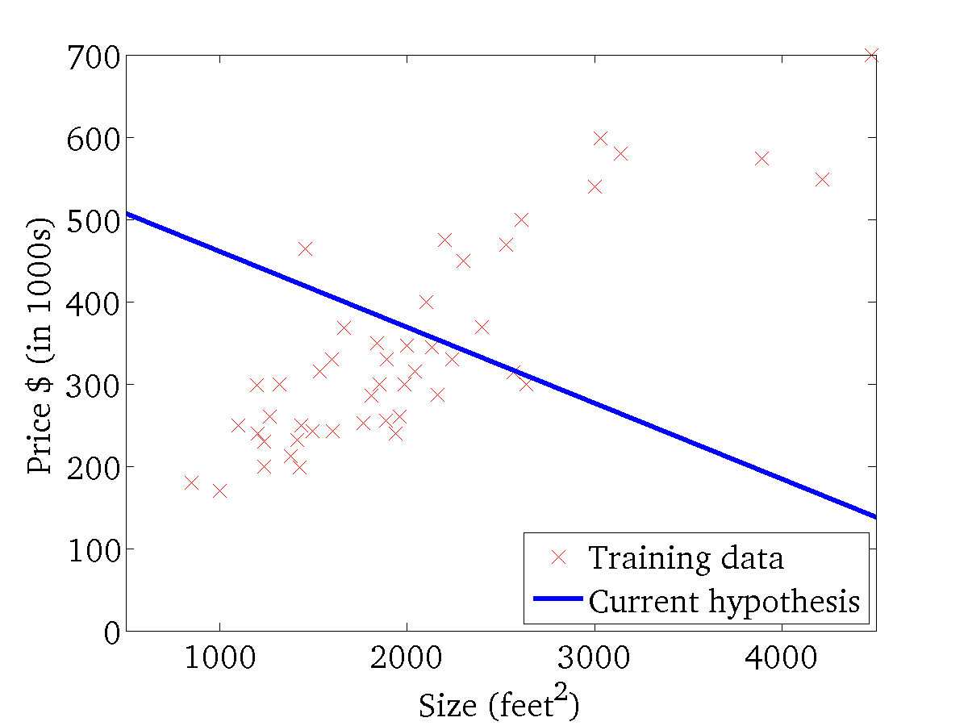

(for fixed , this is a function of x)
(function of the parameters )

Slide 19
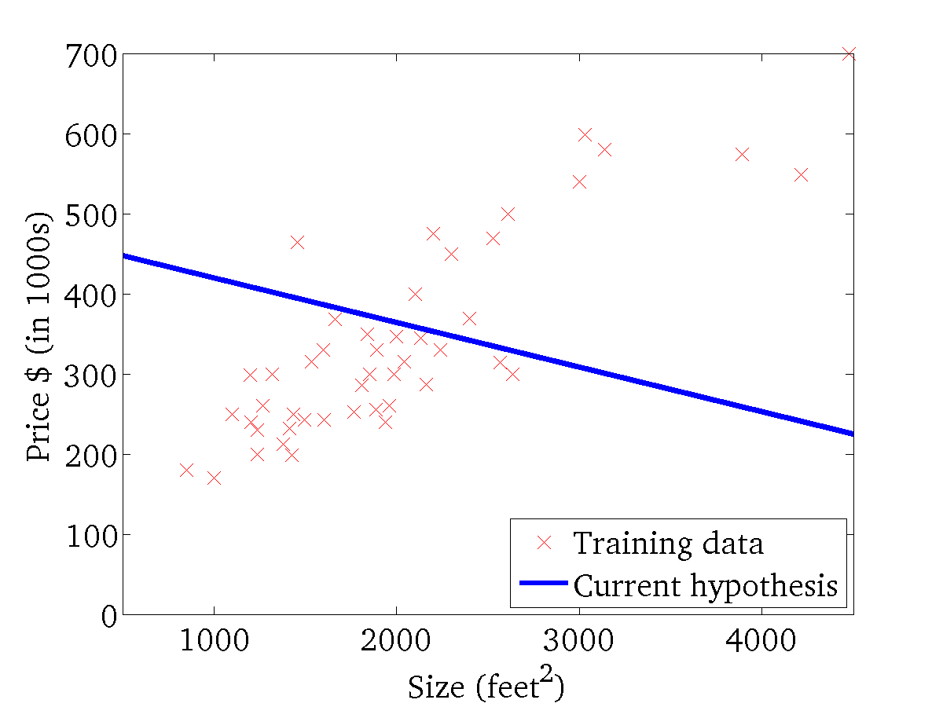
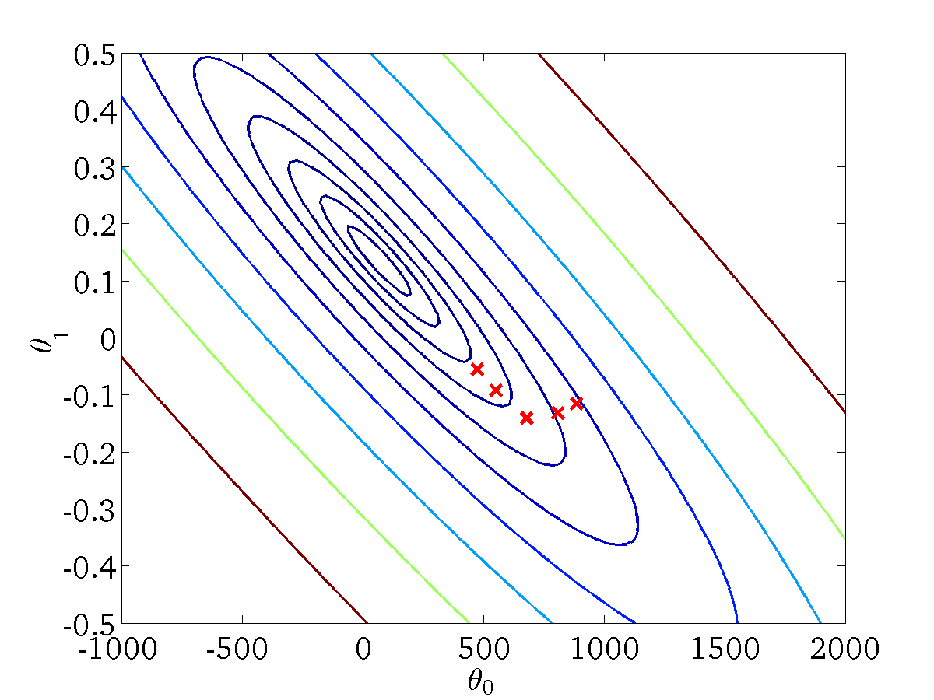
(for fixed , this is a function of x)
(function of the parameters )

Slide 20
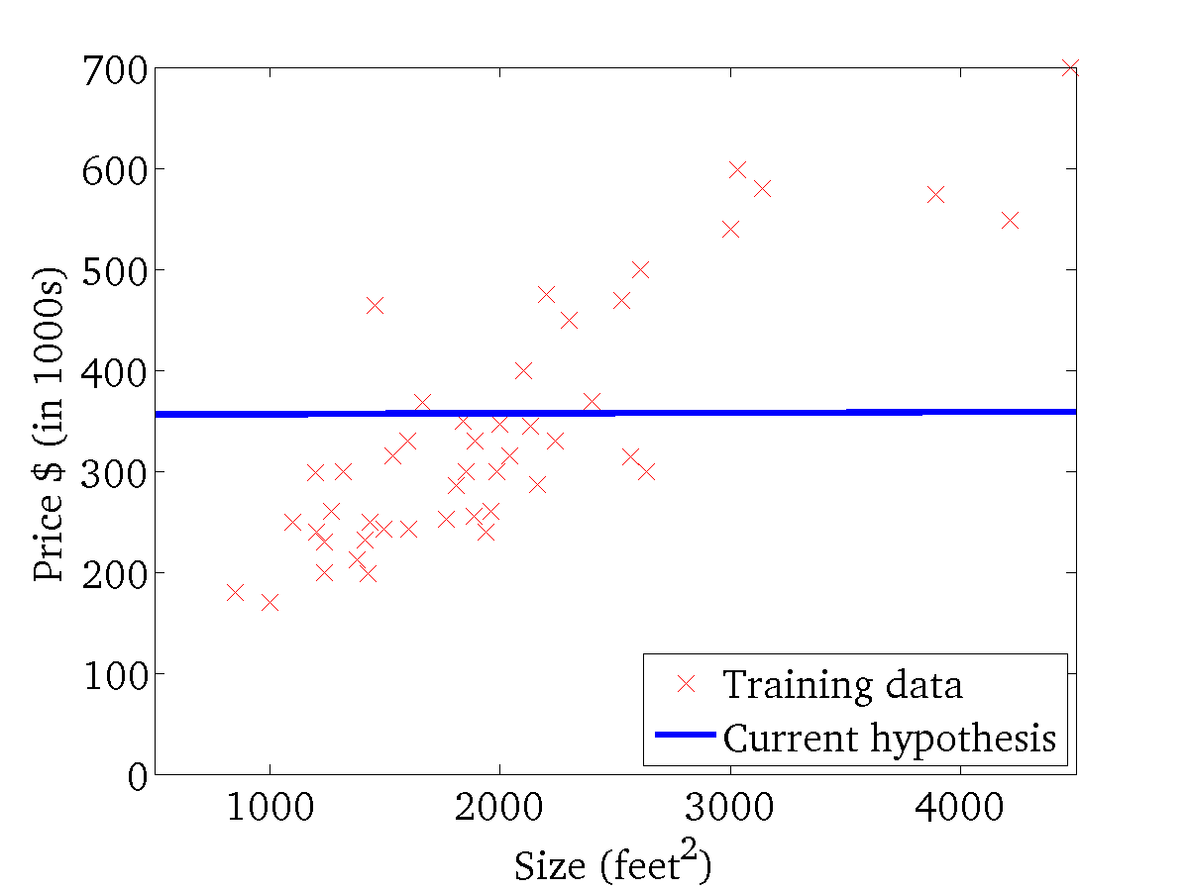

(for fixed , this is a function of x)
(function of the parameters )

Slide 21
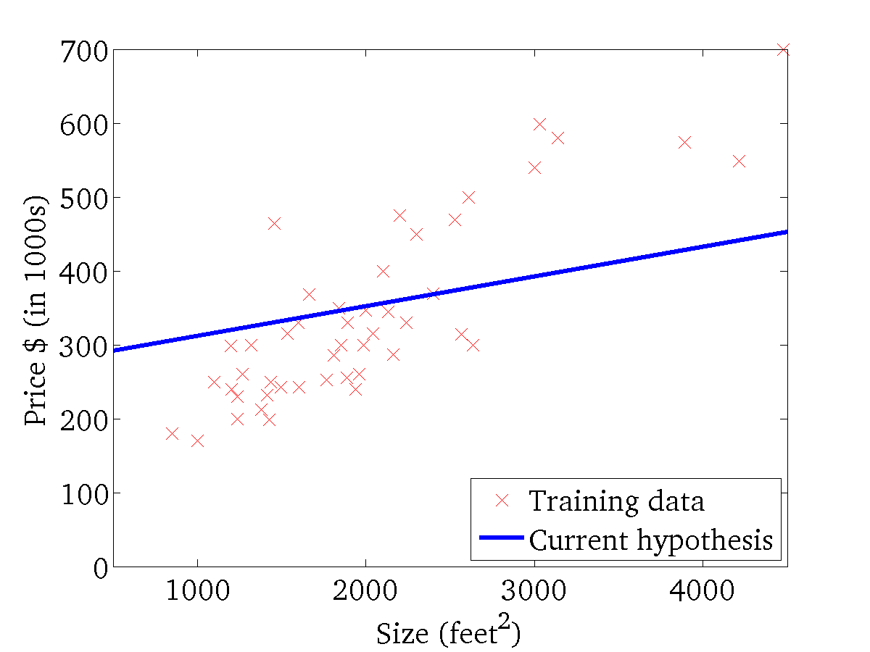

(for fixed , this is a function of x)
(function of the parameters )

Slide 22
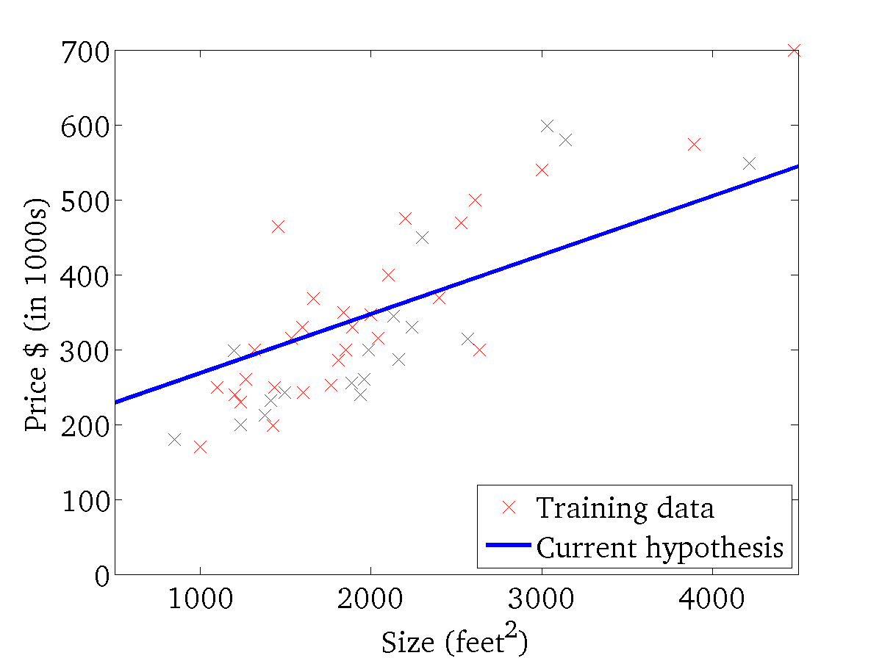
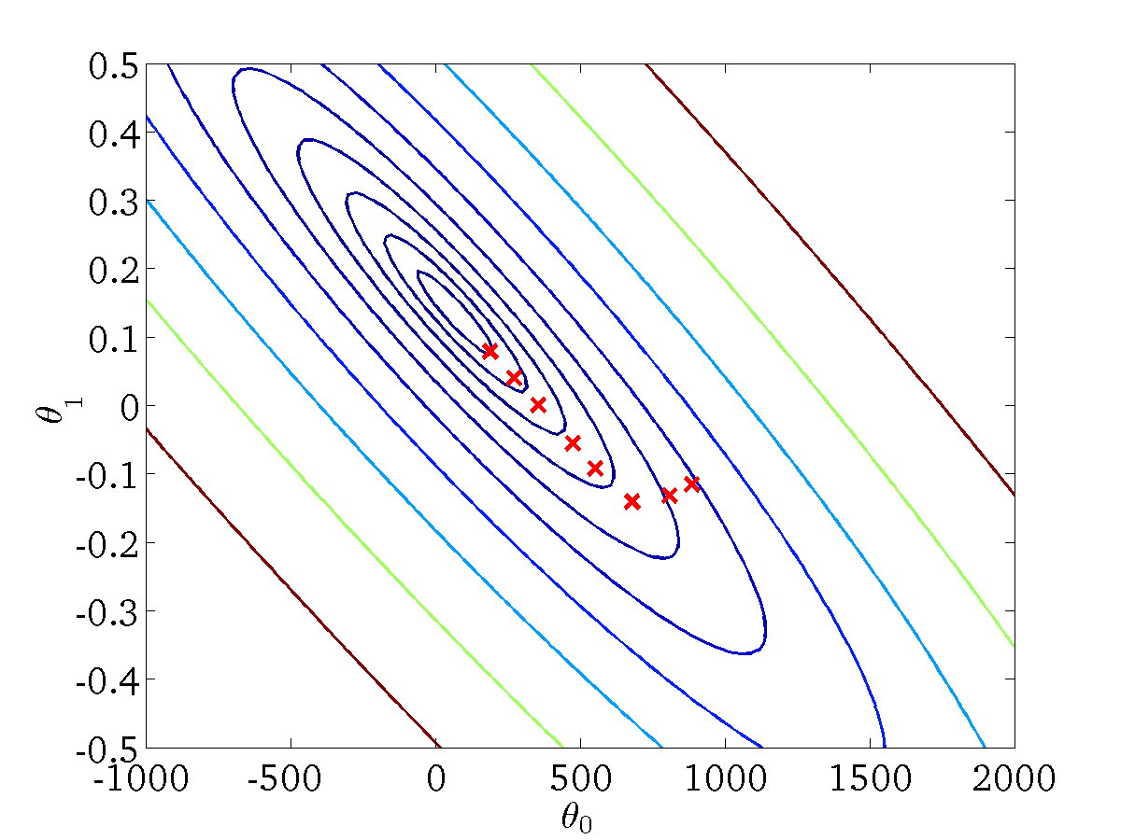
(for fixed , this is a function of x)
(function of the parameters )

Slide 23
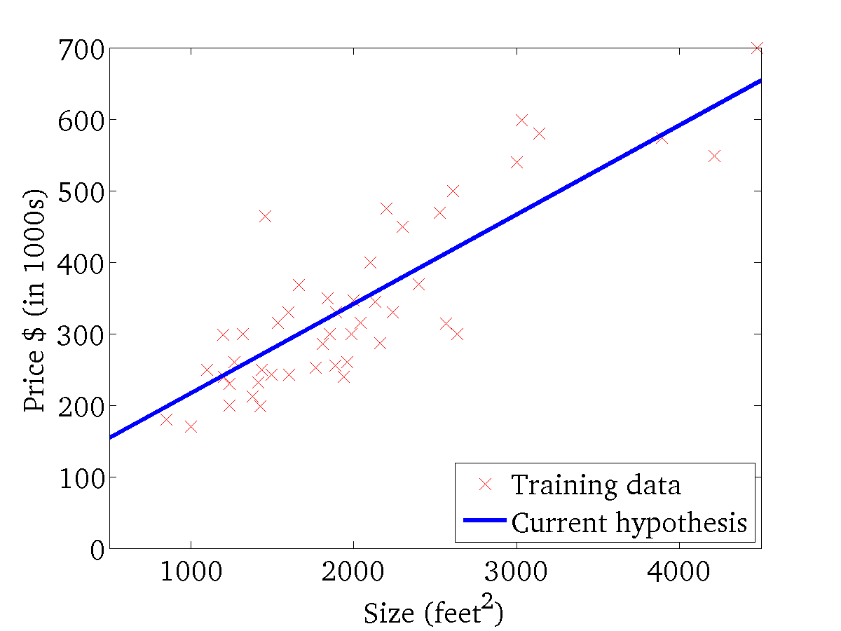

(for fixed , this is a function of x)
(function of the parameters )

Slide 24
The Gradient Descent Algorithm
Goal: Minimize 𝐽 𝜃₀, 𝜃₁
Outline:
Start with some
Keep updating
𝜃₀, 𝜃₁ - For example (0,0)
𝜃₀, 𝜃₁ to reduce 𝐽 𝜃₀, 𝜃₁
Until we hopefully reach a minimum
37

Slide 25
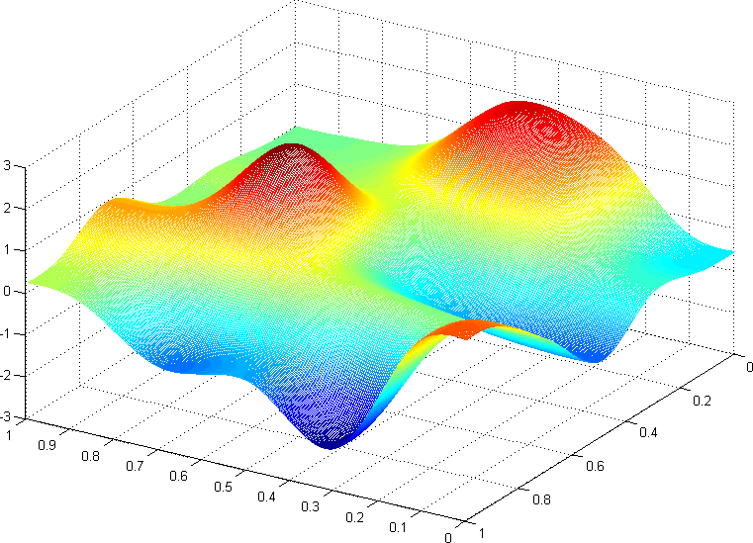


𝐽(𝜃₀, 𝜃₁)
θ₁
θ₀
Andrew Ng

Slide 26


𝐽(𝜃₀, 𝜃₁)
θ₁
θ₀
Andrew Ng

Slide 27
A simplified version of gradient descent
Assume again that we set 𝜃₀ = 0 and our hypothesis and cost function practically have only one coefficient,𝜃₁.
^{ℎ}𝜃 𝑥
= 𝜃₁𝑥
𝑟𝑒𝑝𝑒𝑎𝑡 𝑢𝑛𝑡𝑖𝑙 𝑐𝑜𝑛𝑣𝑒𝑟𝑔𝑒𝑛𝑐𝑒{
𝑑
𝜃 ≔ 𝜃 − 𝛼 (𝐽(𝜃 ))
1
1
𝑑𝜃
1
1
}

Slide 28



Direction of step
3
Negative gradient
𝑑
𝑑𝜃
𝜃₁ ≔ 𝜃₁ − 𝛼
𝐽 𝜃₁
1
2
𝜃₁ ≔ 𝜃₁ − 𝛼 𝑛𝑒𝑔𝑎𝑡𝑖𝑣𝑒 : Increases 𝜃₁
𝜃₁ ≔ 𝜃₁ − 𝛼 𝑝𝑜𝑠𝑖𝑡𝑖𝑣𝑒 : Decreases 𝜃₁
Positive gradient
1
Gradient = 0 at the minimum
0
-0.5
0
0.5
1
1.5
2
2.5

Slide 29
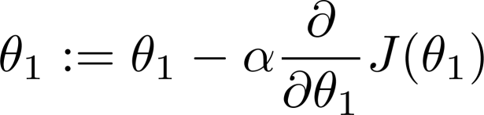
Step size
3
𝑑
𝜃₁ ≔ 𝜃₁ − 𝛼
𝐽 𝜃₁
𝑑𝜃
1
𝜃₁ ≔ 𝜃₁ − 𝛼 𝑛𝑒𝑔𝑎𝑡𝑖𝑣𝑒 : Increases 𝜃₁
𝜃₁ ≔ 𝜃₁ − 𝛼 𝑝𝑜𝑠𝑖𝑡𝑖𝑣𝑒 : Decreases 𝜃₁
2
In addition to 𝛼, the steepness of the
gradient also control the step size.
The step sizes become smaller as we get closer to the minimum, even
with a fixed 𝛼.
With 𝛼 too small, takes a long time
to reach the minimum
1
0
-0.5
0
0.5
1
1.5
2
2.5

Slide 30
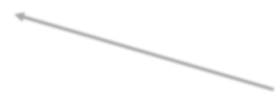



Step size
_{Gradient =} 𝑦₂−𝑦₁ ₌ 𝑓(𝑥₂)−𝑓(𝑥₁)
𝑥₂−𝑥₁ 𝑥₂−𝑥₁
The limiting case is when x₂ approaches x₁
3
= ^{∆𝑦} 𝑎𝑠∆𝑥→0 = ^{𝑑𝑦}
∆𝑥 𝑑𝑥
𝑑
𝜃₁ ≔ 𝜃₁ − 𝛼
𝐽 𝜃₁
𝑑𝜃
1
2
𝜃₁ ≔ 𝜃₁ − 𝛼 𝑛𝑒𝑔𝑎𝑡𝑖𝑣𝑒 : Increases 𝜃₁
𝜃₁ ≔ 𝜃₁ − 𝛼 𝑝𝑜𝑠𝑖𝑡𝑖𝑣𝑒 : Decreases 𝜃₁
In addition to 𝛼, the steepness of the
gradient also control the step size.
The step sizes become smaller as we get closer to the minimum, even
with a fixed 𝛼.
With 𝛼 too small, takes a long time
to reach the minimum
With 𝛼 too big, we can miss the minimum, and may fail to converge
1
0
-0.5
0
0.5
1
1.5
2
2.5

Slide 31

Step size
3
Steeper
The step sizes become smaller as we get closer to the minimum, even
with a fixed 𝛼.
No need to decrease 𝛼 with time or
number of steps
Less steep
2
Gradient = 0 at
the minimum
1
0
-0.5
0
0.5
1
1.5
2
2.5

Slide 32

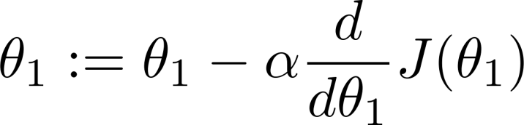
The problem of local optima
at local optima
Current value of

Slide 33
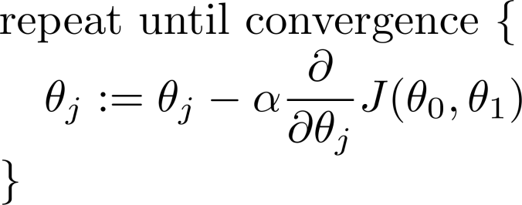

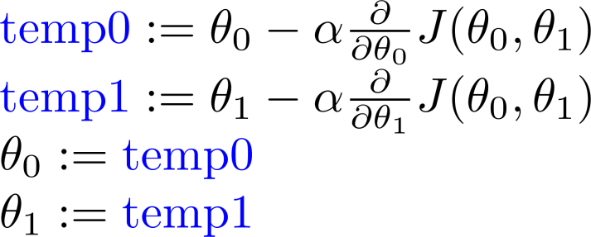
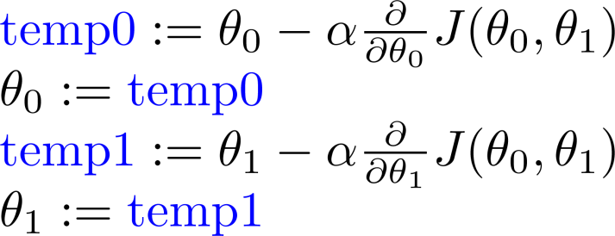
Gradient descent algorithm
(Where α is the learning rate. E.g., 1, 0.1, 0.01, 0.001,… etc.)
Correct: Simultaneous update
Incorrect:

Slide 34
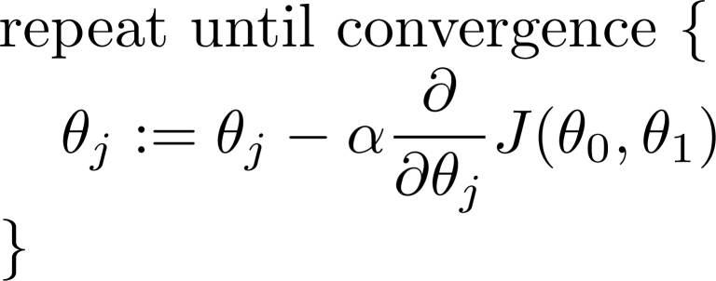
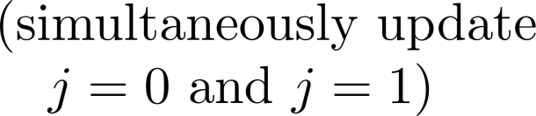
Gradient descent algorithm

Slide 35
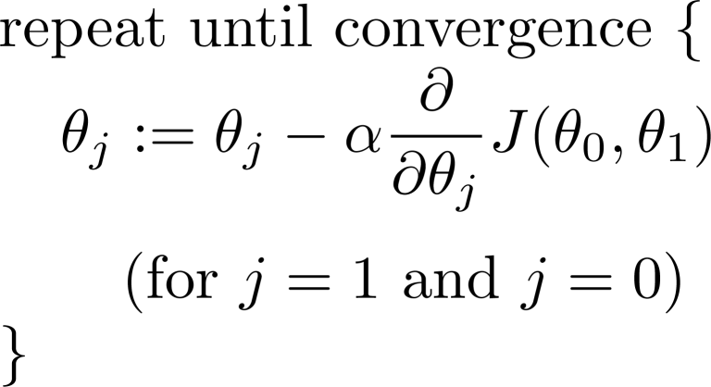
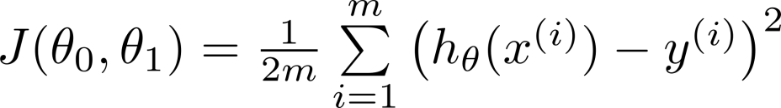
Linear Regression Model
Gradient descent algorithm

Slide 36
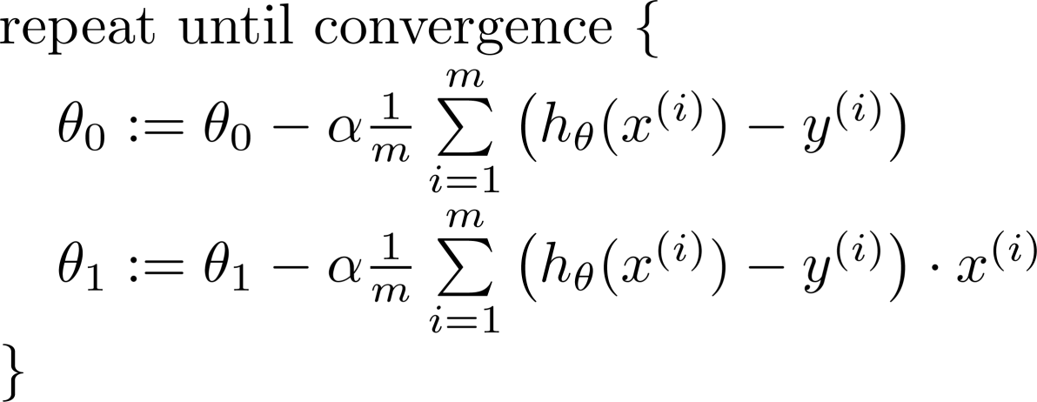

Gradient descent algorithm
update and
simultaneously

Slide 37
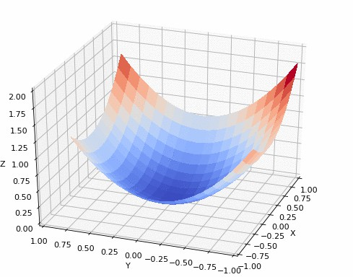
Convex function
https://github.com/pvigier/gradient-descent

Slide 38
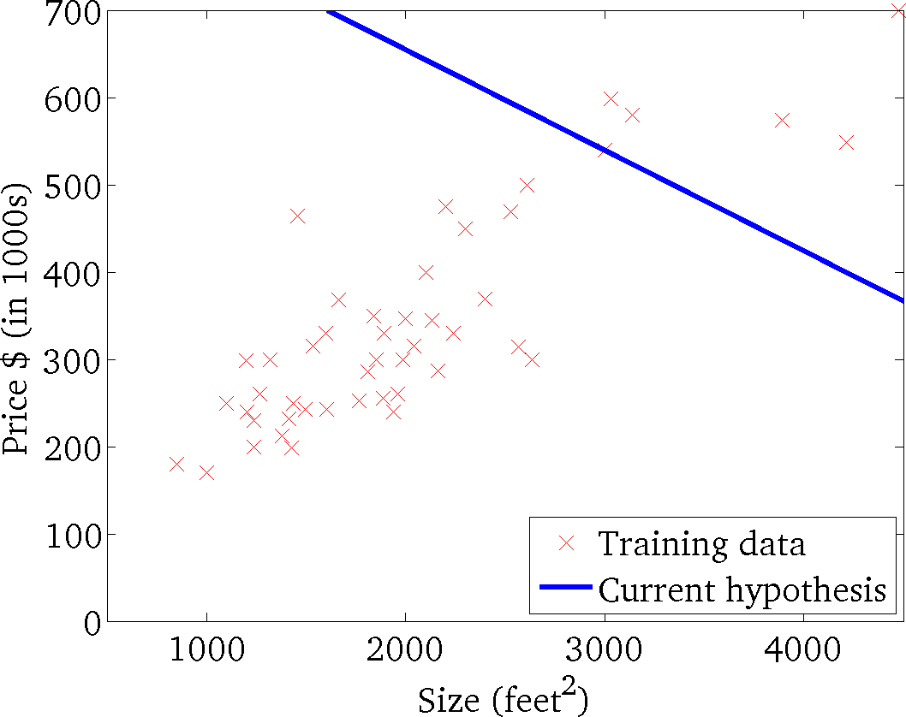
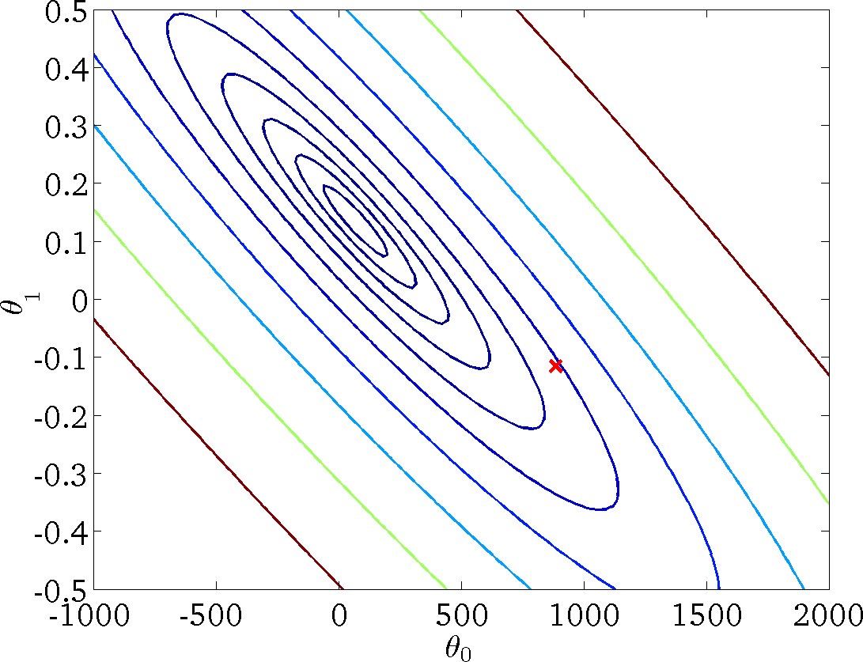
𝒉_{𝜽} 𝒙 = 𝜽_{𝟎} + 𝜽_{𝟏}𝒙
(for fixed 𝜃₀, 𝜃₁, this is a function of 𝑥)
𝑱 𝜽_{𝟎}, 𝜽_{𝟏}
(function of the parameters 𝜃₀, 𝜃₁)

Slide 39

𝒉_{𝜽} 𝒙 = 𝜽_{𝟎} + 𝜽_{𝟏}𝒙
(for fixed 𝜃₀, 𝜃₁, this is a function of 𝑥)
𝑱 𝜽_{𝟎}, 𝜽_{𝟏}
(function of the parameters 𝜃₀, 𝜃₁)

Slide 40
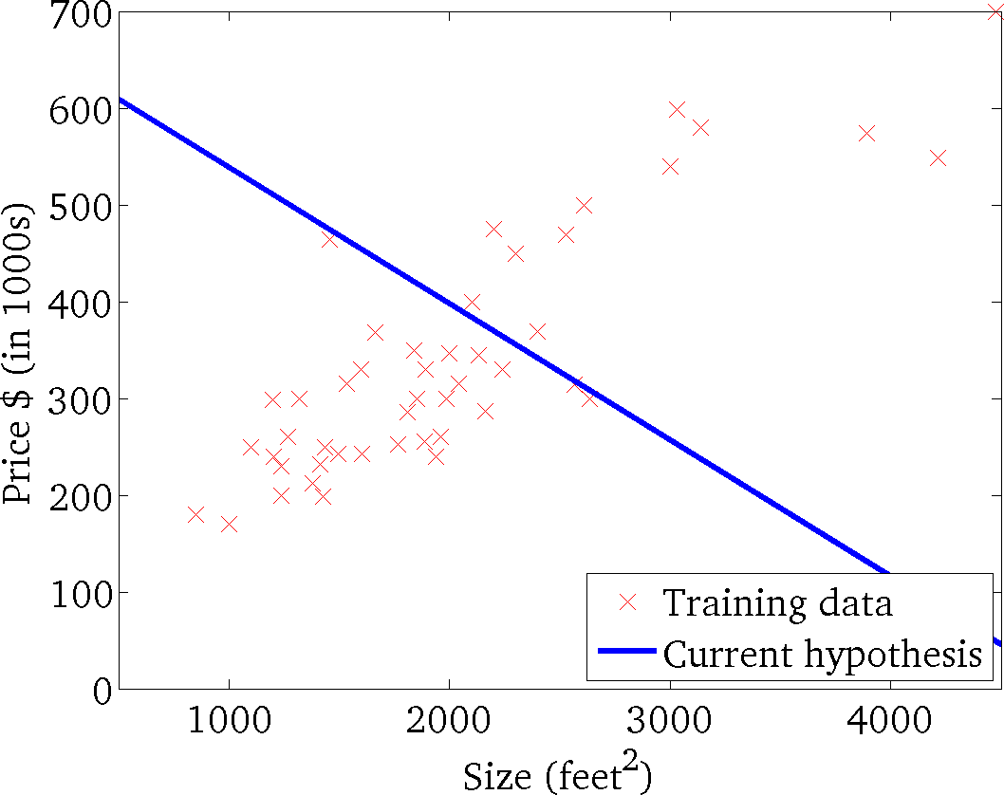

𝒉_{𝜽} 𝒙 = 𝜽_{𝟎} + 𝜽_{𝟏}𝒙
(for fixed 𝜃₀, 𝜃₁, this is a function of 𝑥)
𝑱 𝜽_{𝟎}, 𝜽_{𝟏}
(function of the parameters 𝜃₀, 𝜃₁)

Slide 41
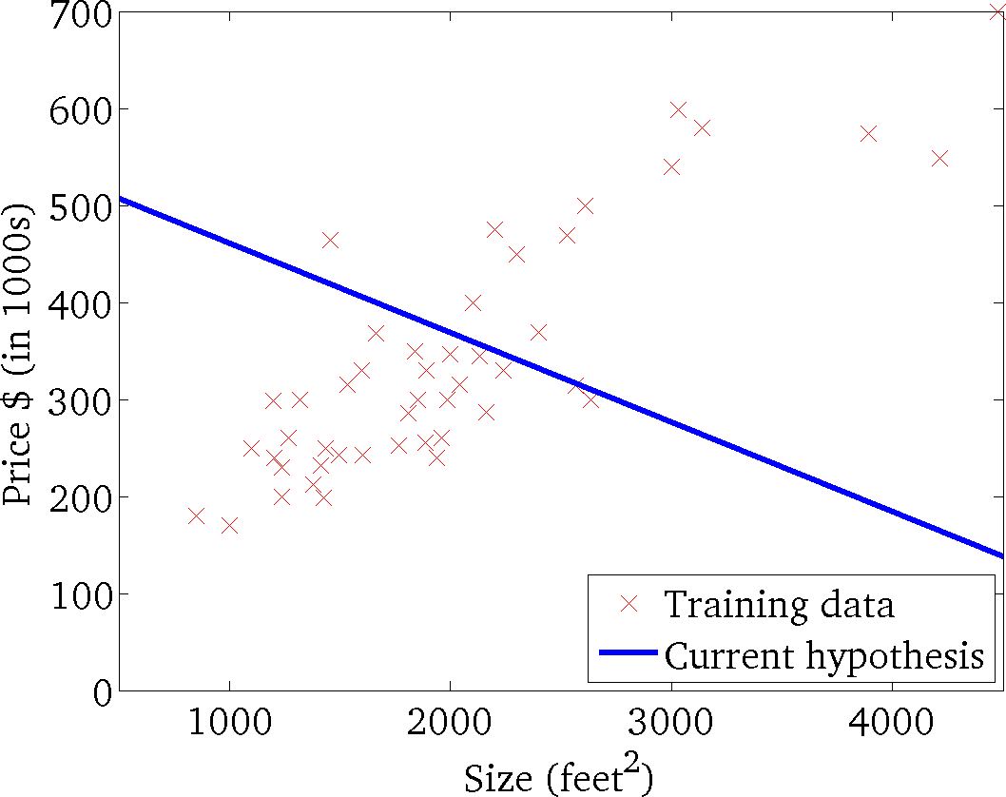
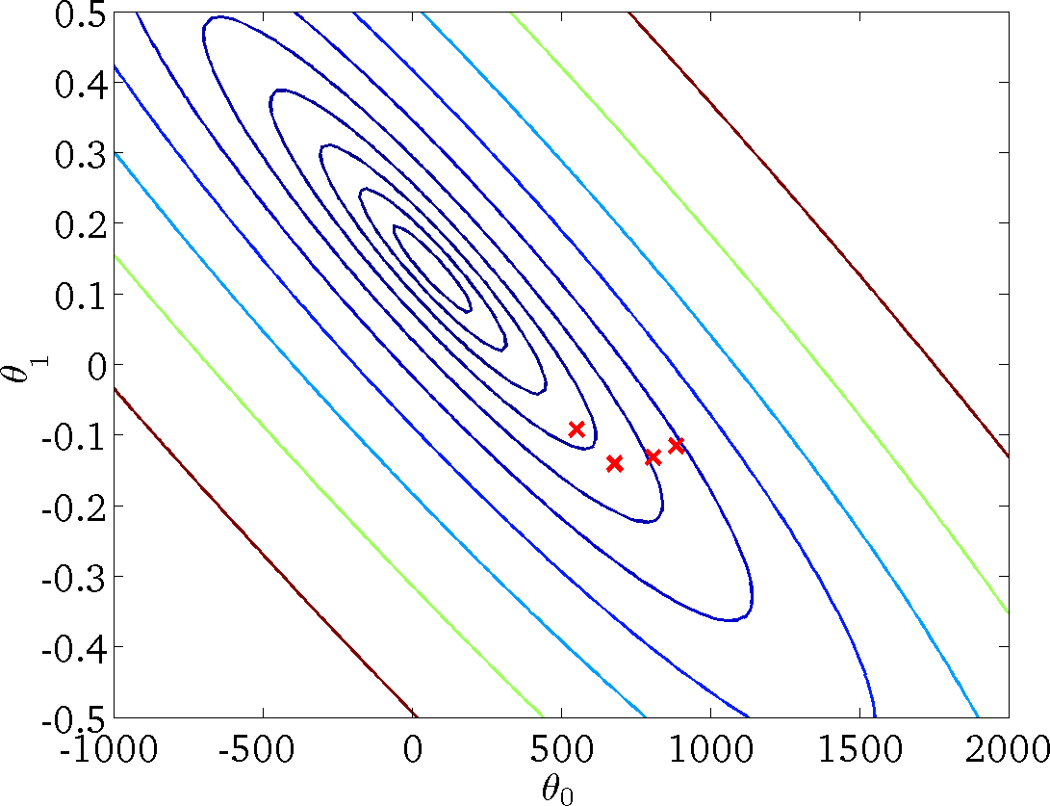
𝒉_{𝜽} 𝒙 = 𝜽_{𝟎} + 𝜽_{𝟏}𝒙
(for fixed 𝜃₀, 𝜃₁, this is a function of 𝑥)
𝑱 𝜽_{𝟎}, 𝜽_{𝟏}
(function of the parameters 𝜃₀, 𝜃₁)

Slide 42
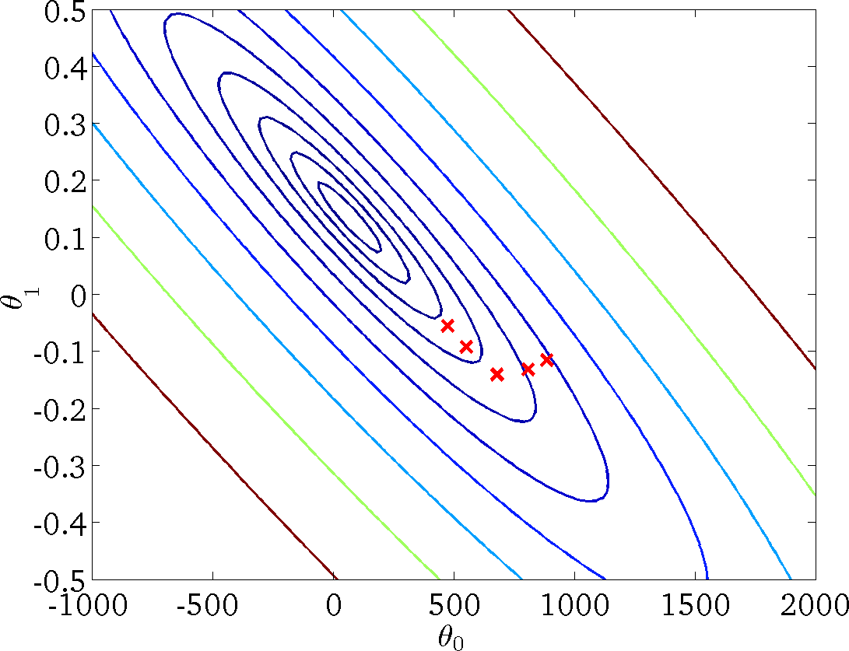
𝒉_{𝜽} 𝒙 = 𝜽_{𝟎} + 𝜽_{𝟏}𝒙
(for fixed 𝜃₀, 𝜃₁, this is a function of 𝑥)
𝑱 𝜽_{𝟎}, 𝜽_{𝟏}
(function of the parameters 𝜃₀, 𝜃₁)

Slide 43
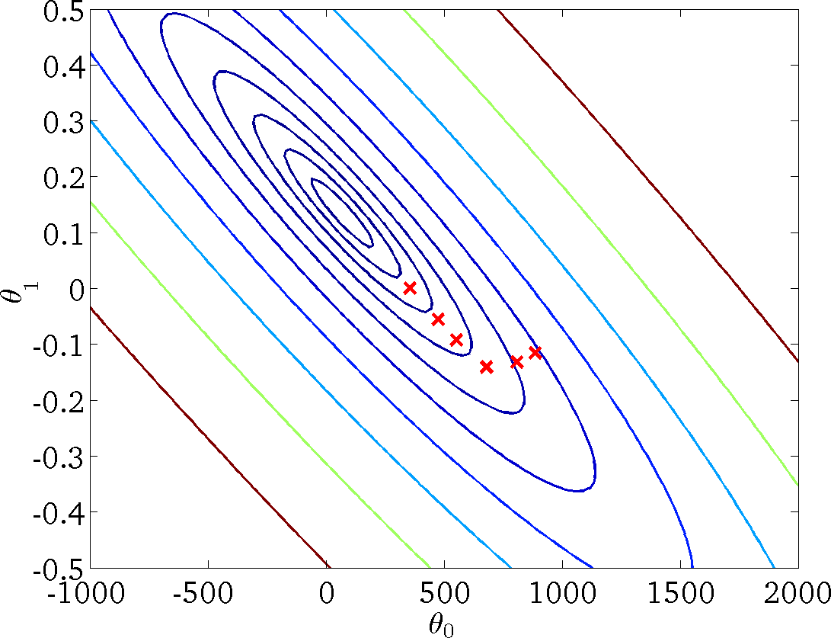
𝒉_{𝜽} 𝒙 = 𝜽_{𝟎} + 𝜽_{𝟏}𝒙
(for fixed 𝜃₀, 𝜃₁, this is a function of 𝑥)
𝑱 𝜽_{𝟎}, 𝜽_{𝟏}
(function of the parameters 𝜃₀, 𝜃₁)

Slide 44
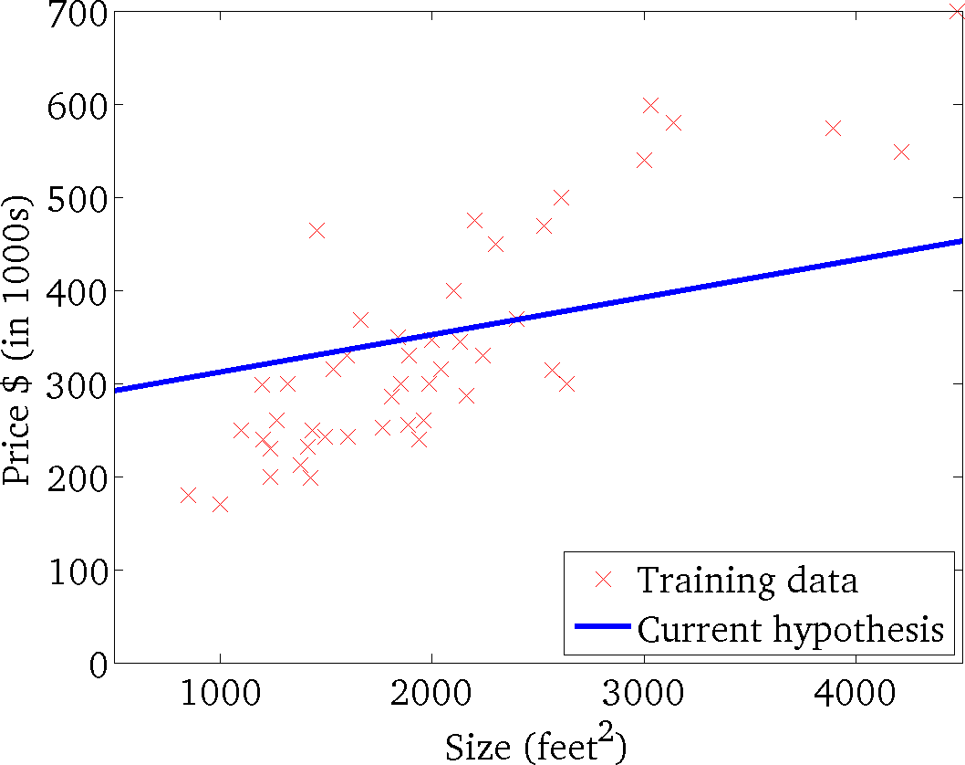
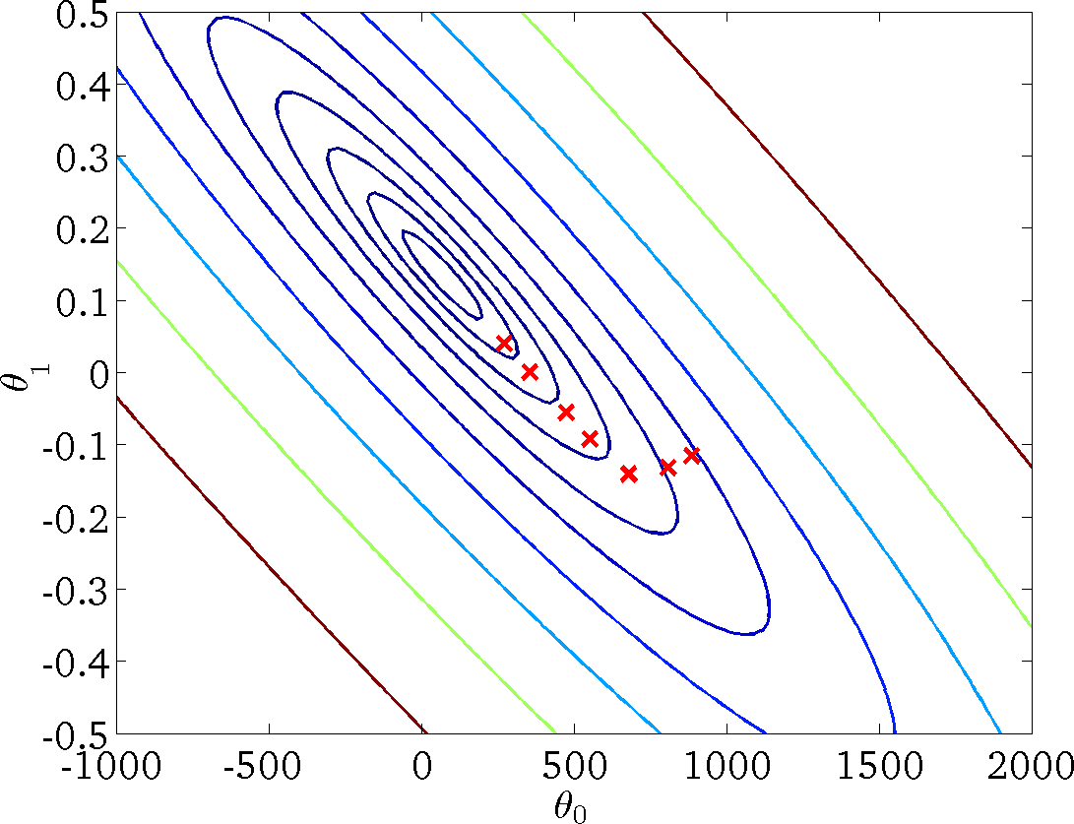
𝒉_{𝜽} 𝒙 = 𝜽_{𝟎} + 𝜽_{𝟏}𝒙
(for fixed 𝜃₀, 𝜃₁, this is a function of 𝑥)
𝑱 𝜽_{𝟎}, 𝜽_{𝟏}
(function of the parameters 𝜃₀, 𝜃₁)

Slide 45
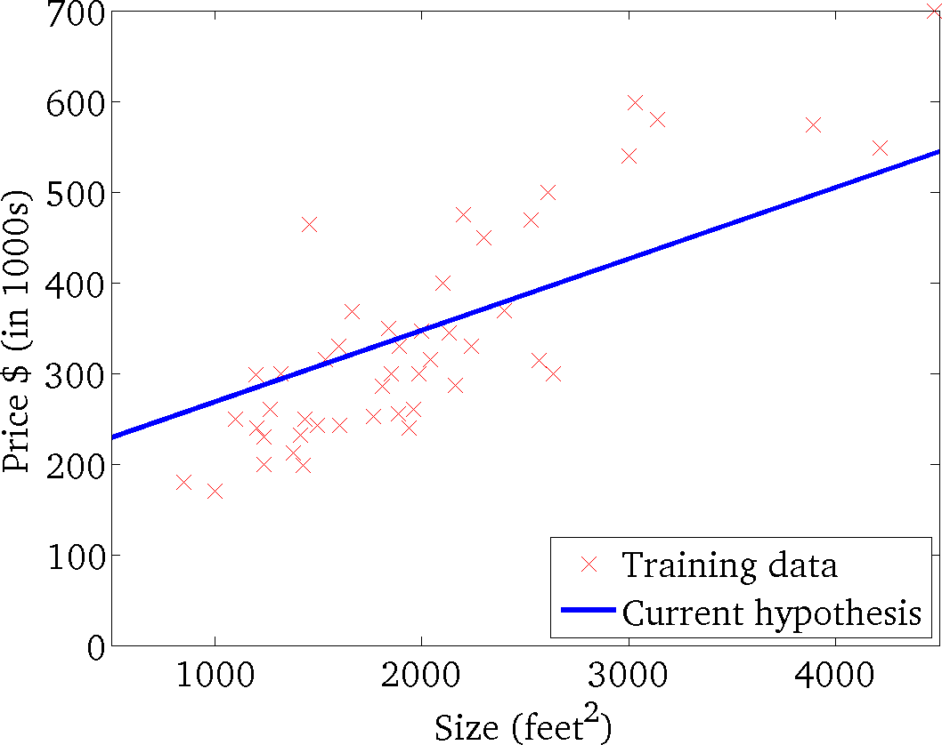
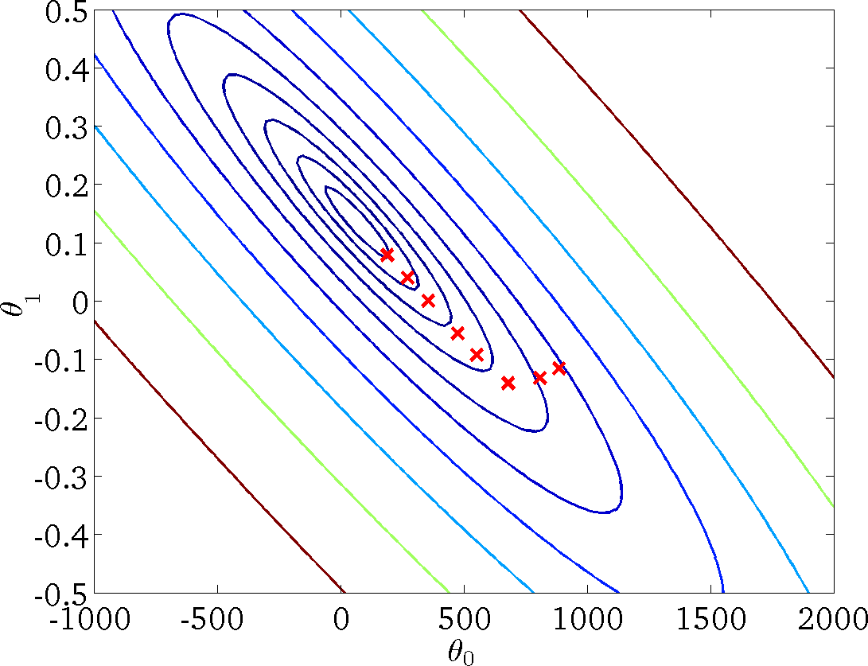
𝒉_{𝜽} 𝒙 = 𝜽_{𝟎} + 𝜽_{𝟏}𝒙
(for fixed 𝜃₀, 𝜃₁, this is a function of 𝑥)
𝑱 𝜽_{𝟎}, 𝜽_{𝟏}
(function of the parameters 𝜃₀, 𝜃₁)

Slide 46
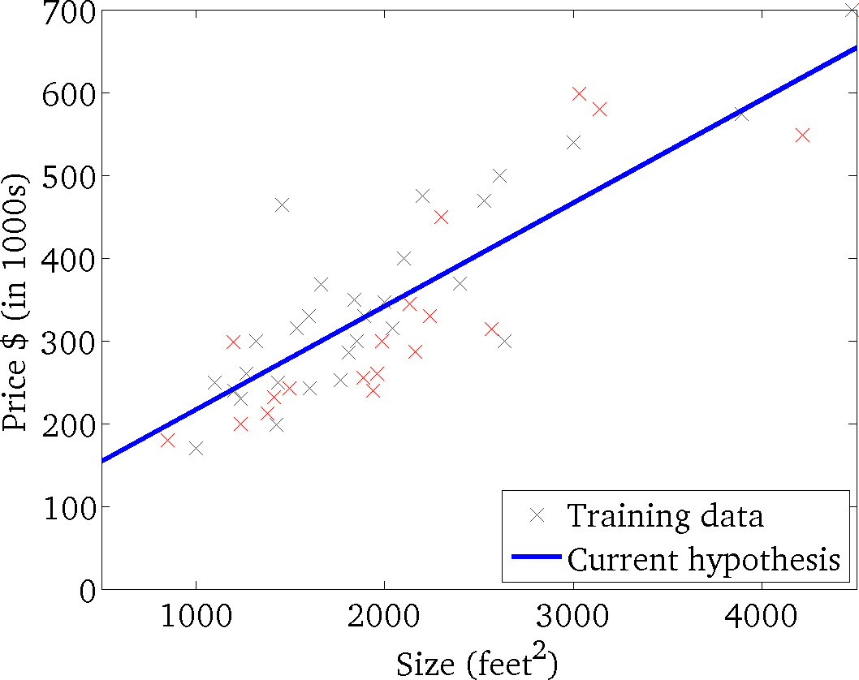

𝒉_{𝜽} 𝒙 = 𝜽_{𝟎} + 𝜽_{𝟏}𝒙
(for fixed 𝜃₀, 𝜃₁, this is a function of 𝑥)
𝑱 𝜽_{𝟎}, 𝜽_{𝟏}
(function of the parameters 𝜃₀, 𝜃₁)

Slide 47
Applications
Economic Growth
Linear regression is used to determine the economic growth of a country or a state in the
upcoming quarter. It can also be used to predict a nation’s gross domestic product (GDP).
Product Price
Linear regression can be used to predict what the price of a product will be in the future,
whether prices will go up or down.
Housing Sales
Linear regression can be used to estimate the number of houses a builder will sell in the
coming months and at what price.
Score Predictions
Linear regression can be used to predict the number of runs a baseball player will score in
upcoming games based on previous performance.

